Slide 1
Centennial Center Grants and Fellowships
April 1, 2025
DR. Rosalie Rubio, Associate Director
CENTENNIAL CENTER FOR POLITICAL SCIENCE AND PUBLIC AFFAIRS

Slide 2
Overview: Centennial Center Grants & Opportunities
Spring CCRG
Deadline: April 15th each year
Summer CCRG
Deadline: June 15th each year
Special Projects Fund
Deadline: Variable
$2,500
Targeted constituency
$2,500 for research OR $10,000 for events/workshops
All political scientists eligible
$25,000 for collaborative projects aimed at advancing the political science discipline.

Slide 3
Context: Funding Sources for Centennial Center Grants and Programs
Spring CCRG
APSA operating budget
Set amount, usually ~ $40,000
Summer CCRG
Endowments
4% draw, amount varies
based on stock market
Special Projects Fund
Variable
Contingent on APSA council approval

Slide 4
Centennial Center Research Grants: Eligible Costs
Research costs associated with data collection, including costs of conducting interviews and surveys, access to archives, and more.
Salary support for research assistants
Per diems regardless of travel/location
Research software and hardware, including statistical software, productivity software, and devices necessary for scholars with disabilities to conduct their research.
And more! We recognize that APSA members may have research needs not included in the above list. If you have a cost that is not listed here, please contact us at centennial@apsanet.org.

Slide 5
Centennial Center Research Grants: Evaluation Criteria
Summer/Spring 2025
Originality: To what extent do the proposed research activities suggest and explore creative, original, under-studied or potentially transformative topics?
Contribution: Does the proposed work contribute to existing scholarship?
Feasibility: Is the plan for carrying out the proposed activities well-reasoned, well-organized, and based on a sound rationale?
Budget: Does the proposed budget for this project seem reasonable?
Qualifications: How well-qualified is the individual or team to conduct the proposed activities?

Slide 6
Spring Centennial Center Research Grants
Supports research in all fields of political science conducted by:
Political scientists in non-tenure track or contingent positions who are ineligible for departmental funding
Political science faculty of all ranks who are employed in departments that do not grant PhDs.
Postdoctoral Research Fellows
Graduate students currently enrolled in a Political Science PhD program.
Maximum grant amount: $2,500.
Deadline: April 15th of each year.
Application requires: CV, abstract, short proposal, budget.
Graduate students 1-2 recommendation letters

Slide 7
Spring CCRG Timeline PLEASE NOTE: Timeline is Approximate
15 April
Applications Due
15–30 April
Reviewers Assigned
1–31 May
Review Process
15 June
Award Decisions Announced
30 June
Finance Forms Submitted
15 July
Payments Remitted

Slide 8
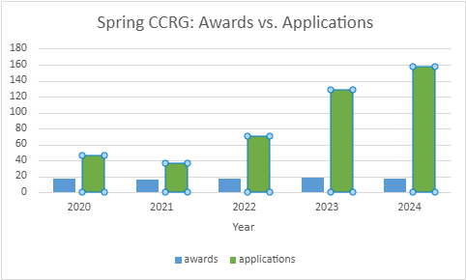
Spring Research Grants Application numbers for Centennial Center Research Grants continue to grow.
Spring CCRG 2020-2024
Year | Total Awarded | Awards | Applications
2020 | $39,172.00 | 17 | 46
2021 | $39,552.00 | 16 | 37
2022 | $41,462.00 | 17 | 70
2023 | $44,616.50 | 18 | 129
2024 | $40,000.00 | 17 | 158

Slide 9
Summer Centennial Center Research Grants
Summer Centennial Center Research Grants are open to all APSA members.
Grants are supported by a set of endowed funds, some of which target specific research topics.
Limited number of grants for mini-conferences, workshops, and other collaborative projects.
Maximum grant amount for research: $2,500
Maximum grant amount for conferences, workshops, etc.: $10,000
Deadline: June 15th of each year.
Application requires: CV, abstract, short proposal, budget, reference/recommendation letters*
1-2 Recommendation letters for ALL graduate student applicants
1-2 Reference letters for all applicants requesting more than $5,000

Slide 10
Summer CCRG Timeline PLEASE NOTE: Timeline is Approximate
15 June
Applications Due
15–30 June
Reviewers Assigned
1–31 July
Review Process
15 August
Award Decisions Announced
30 August
Finance Forms Submitted
15 September
Payments Remitted

Slide 11
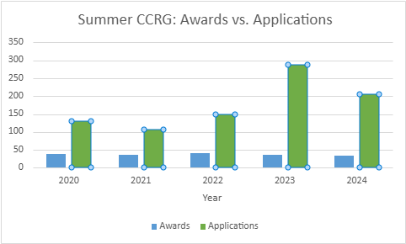
Summer Research Grants Application numbers for Centennial Center Research Grants continue to grow.
Summer CCRG 2020-2024
Year | Total Awarded | Awards | Applications
2020 | $97,193.00 | 38 | 131
2021 | $111,588.00 | 36 | 107
2022 | $123,634.00 | 41 | 150
2023 | $90,500.00 | 36 | 288
2024 | $122,573.00 | 33 | 205

Slide 12
Special Projects Fund (SPF)
Projects must be evidence-based and provide wider benefits for the profession and the discipline.
Projects must be collaborative (involving multiple political scientists, ideally from multiple institutions) and can be focused on any area of disciplinary work, inclusive of teaching, research, service, and public engagement.
Proposals that are for a traditional scholarly project (e.g. production of a single author book or journal article) will not be accepted.
The special projects fund will NOT be offered in 2025
Grant is contingent on funding availability and APSA council approval.
Visit the Centennial Center website for more details in the future.

Slide 13
Final Reminders
Upcoming Deadlines
Spring CCRG: April 15th
Summer CCRG: June 15th
Keep an eye on member newsletters, email lists, social media.
This where you are most likely to get details and reminders on upcoming opportunities.
Visit the Centennial Center microsite:
https://connect.apsanet.org/centennialcenter/
NOTE: currently under construction, updates coming soon.
Contact us!
Centennial Center- centennial@apsanet.org
Rosalie Rubio- rrubio@apsanet.org

